Slide 1
Summary of the 2023 ERA Registry Annual Report

Slide 2
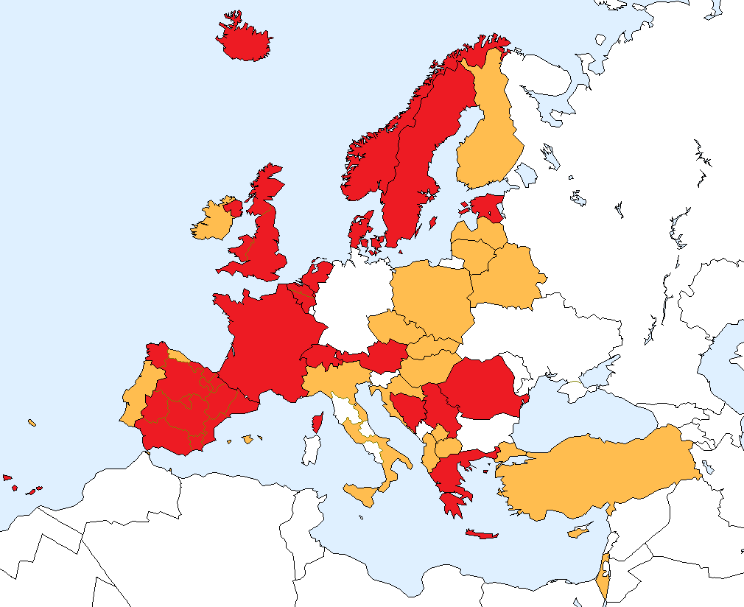
National and regional renal registries that contributed
data to the 2023 ERA Registry Annual Report
Renal registries contributing with individual patient data
Renal registries contributing with aggregated data

Slide 3
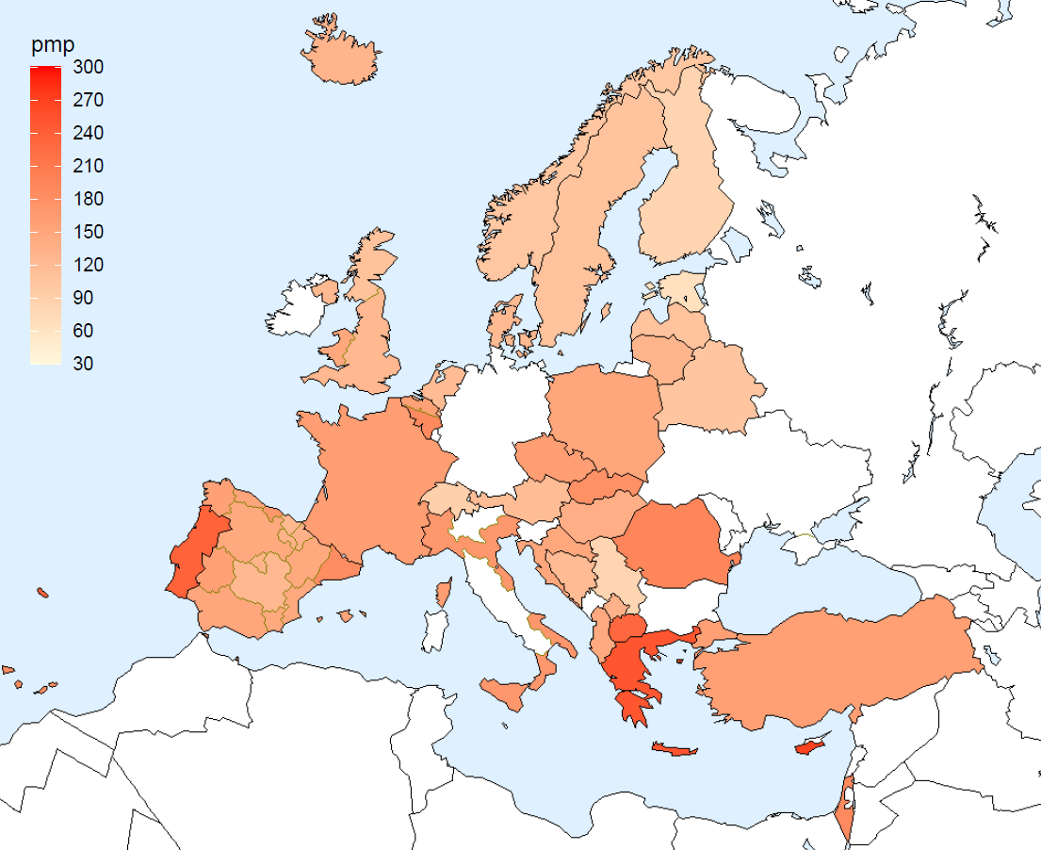
Incident patients accepted for KRT in 2023, at day 1
by country
per million
population
Iceland
Sweden
Norway
Finland
Estonia
DK
Latvia
United
Kingdom
Lithuania
NL
Belarus
Belgium
Poland
Czech
Republic
France
Slovakia
Switzerland
Austria
Portugal
Hungary
Romania
Spain
Croatia
BA
Italy
Serbia
XK
MK
AL
Turkey
Greece
Cyprus
Israel

Slide 4
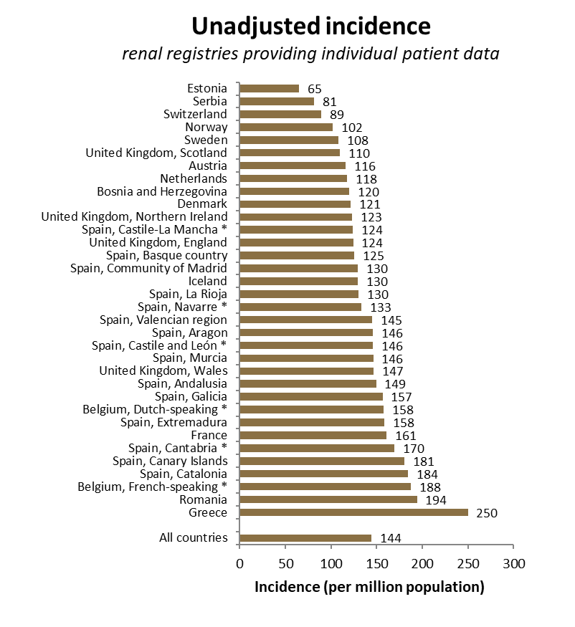
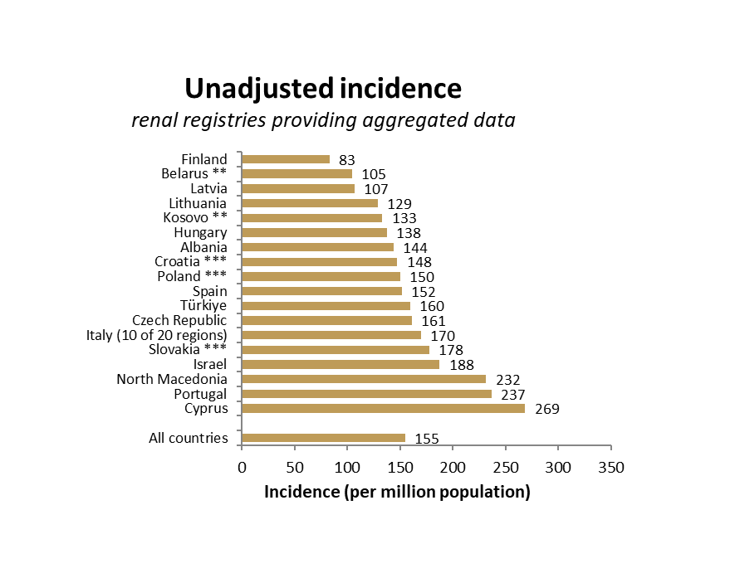
Incident patients accepted for KRT in 2023, at day 1
by country
* patients younger than 20 years of age are not included; ** patients younger than 18 years of age are not included; *** data includes patients receiving dialysis only

Slide 5
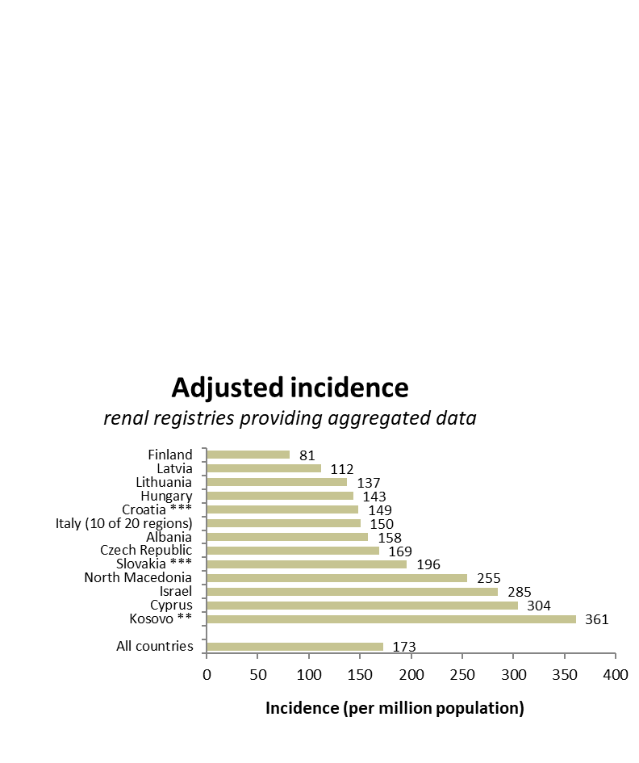
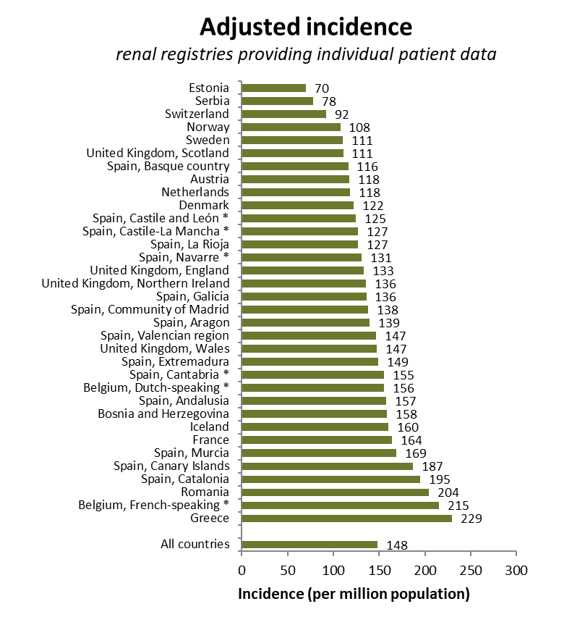
Incident patients accepted for KRT in 2023, at day 1 by country, adjusted for age and sex
* patients younger than 20 years of age are not included; ** patients younger than 18 years of age are not included; *** data includes patients receiving dialysis only

Slide 6
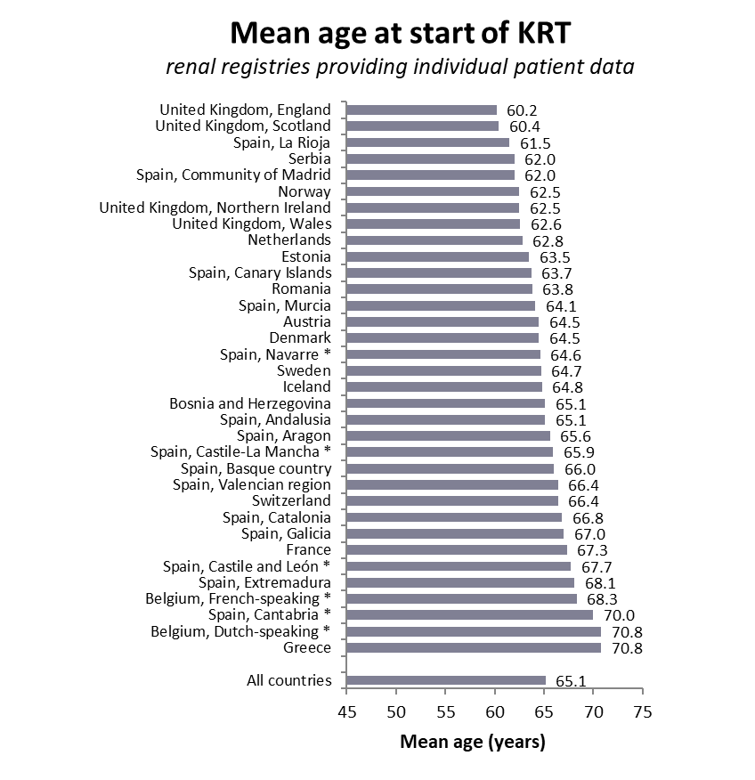
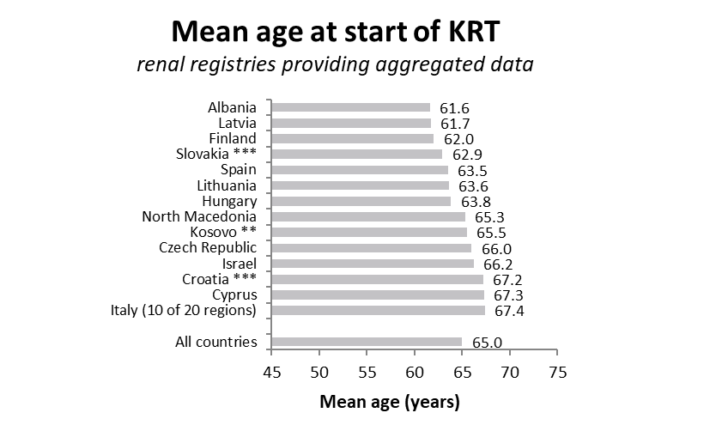
Incident patients accepted for KRT in 2023, at day 1
mean age
* patients younger than 20 years of age are not included; ** patients younger than 18 years of age are not included; *** data includes patients receiving dialysis only

Slide 7
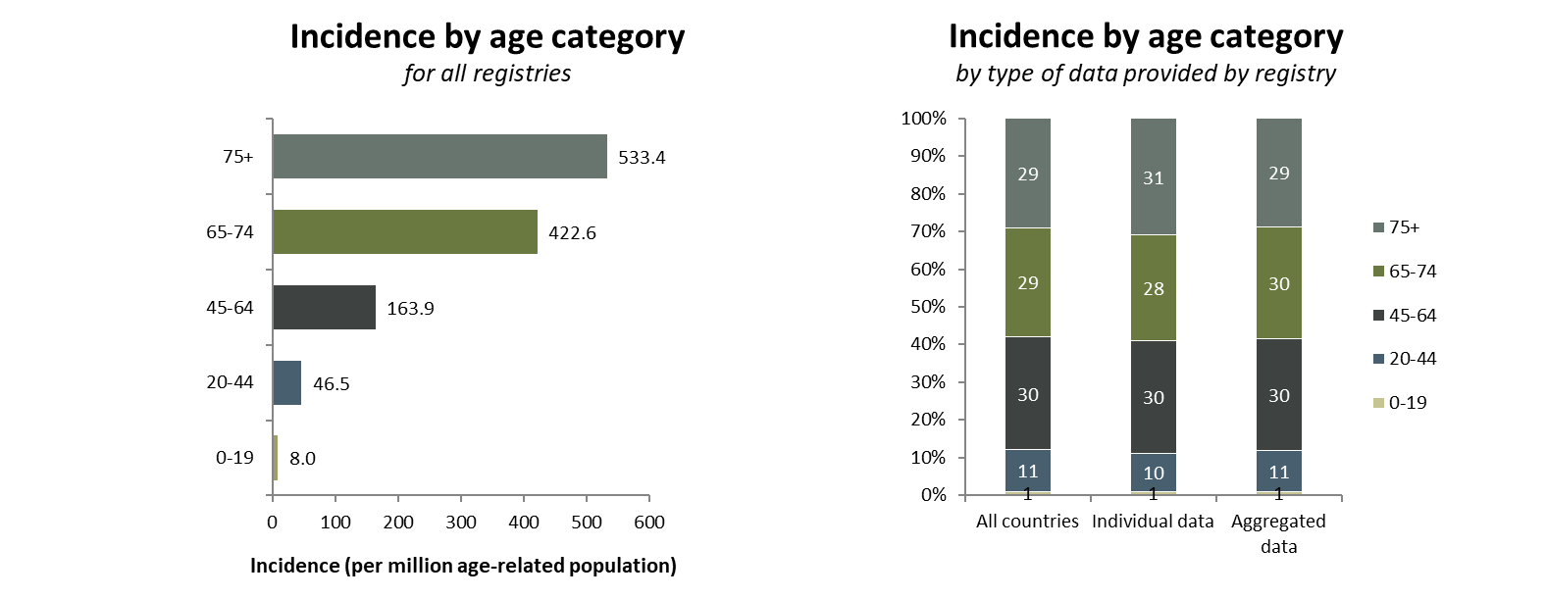
Incident patients accepted for KRT in 2023, at day 1
by age category

Slide 8
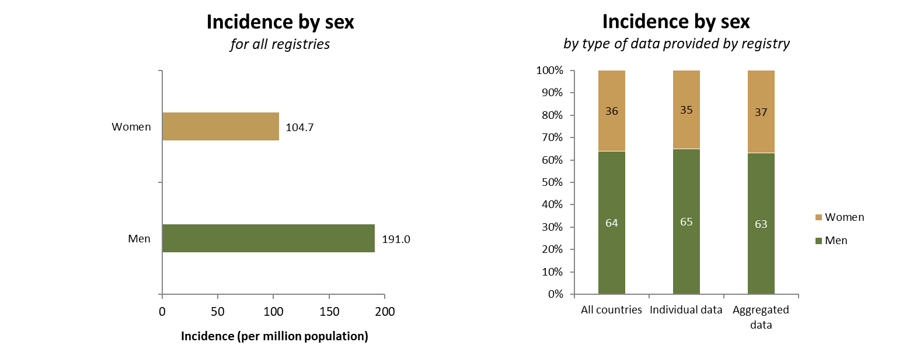
Incident patients accepted for KRT in 2023, at day 1 by sex

Slide 9
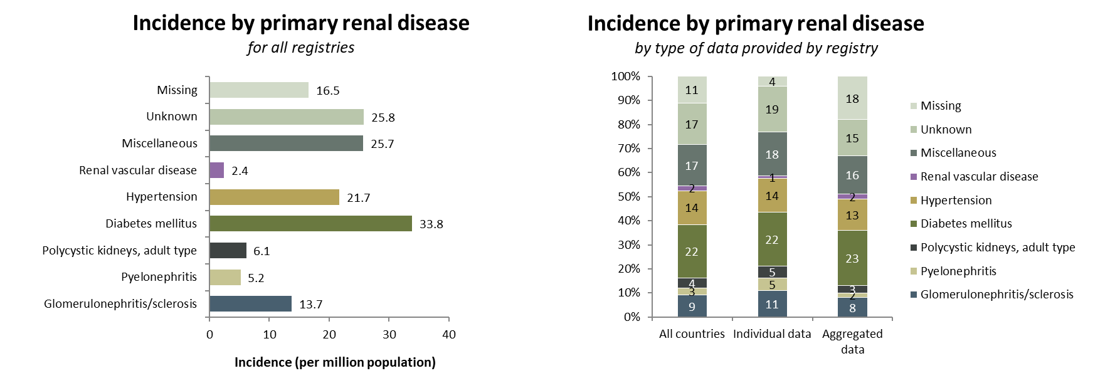
Incident patients accepted for KRT in 2023, at day 1 by primary renal disease (1995 PRD codes)

Slide 10
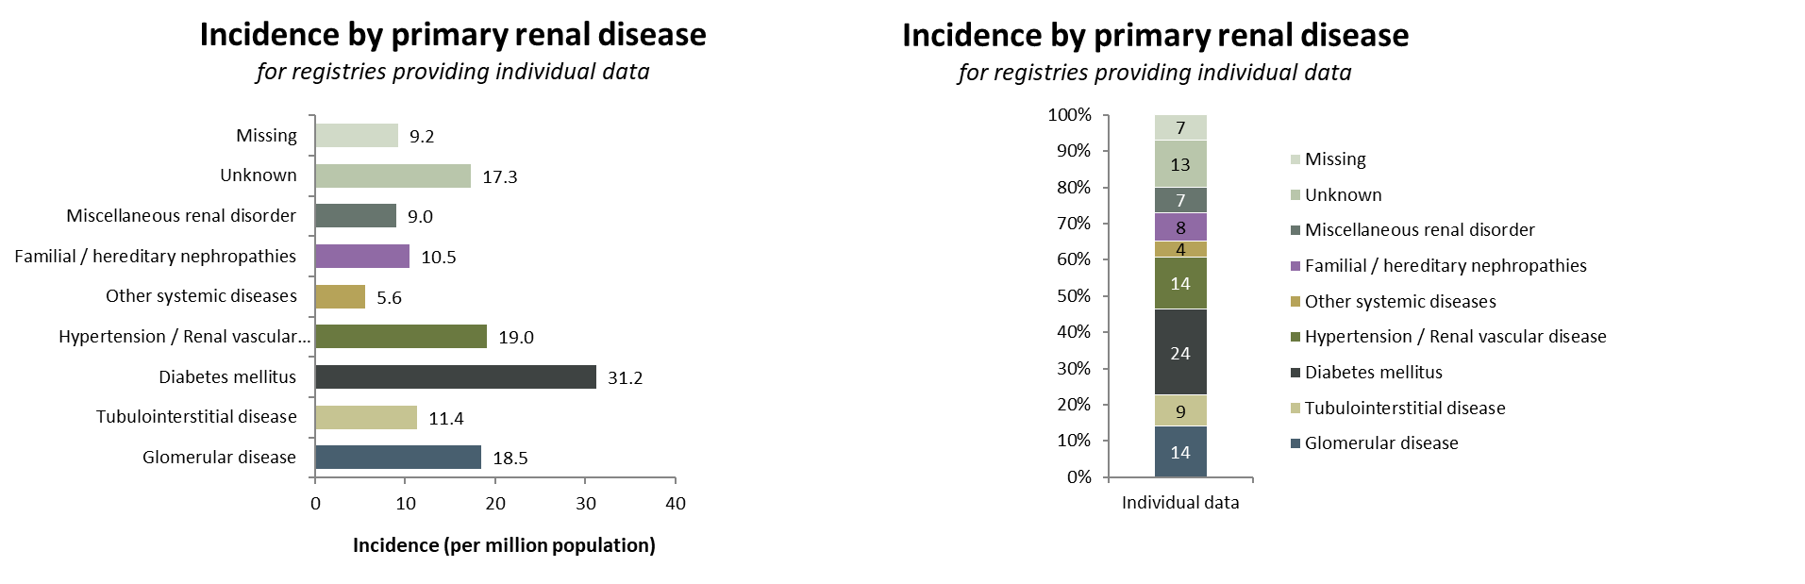
Incident patients accepted for KRT in 2023, at day 1 by primary renal disease (2012/2018 PRD codes)

Slide 11
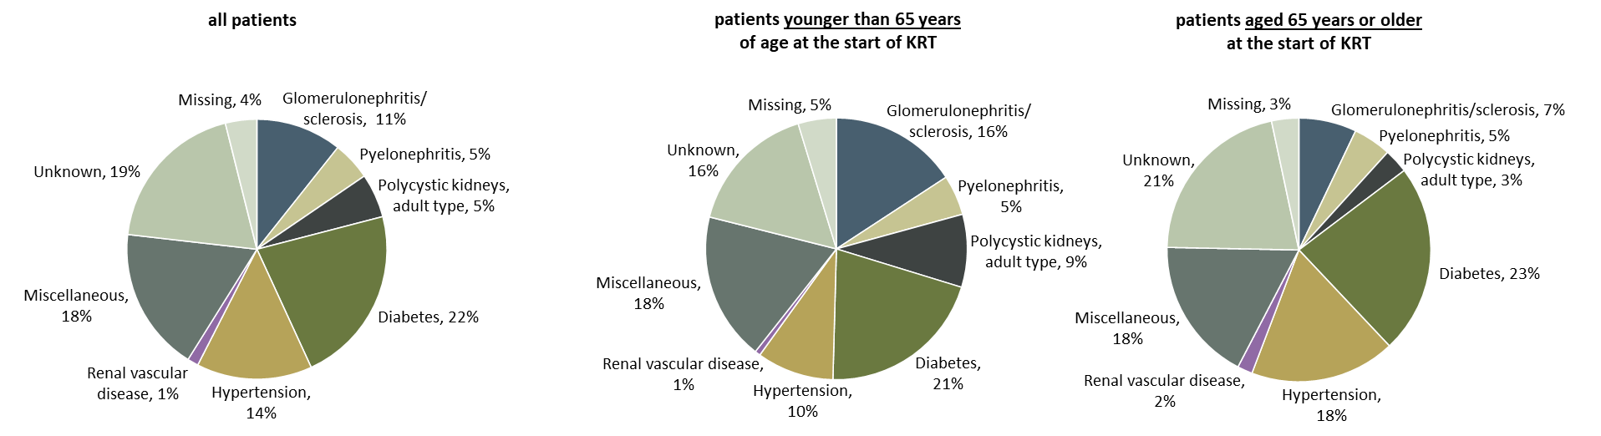
Incident patients accepted for KRT in 2023, at day 1 by primary renal disease (1995 PRD codes) and age category
Incidence by primary renal disease
patients from registries providing individual patient data only

Slide 12
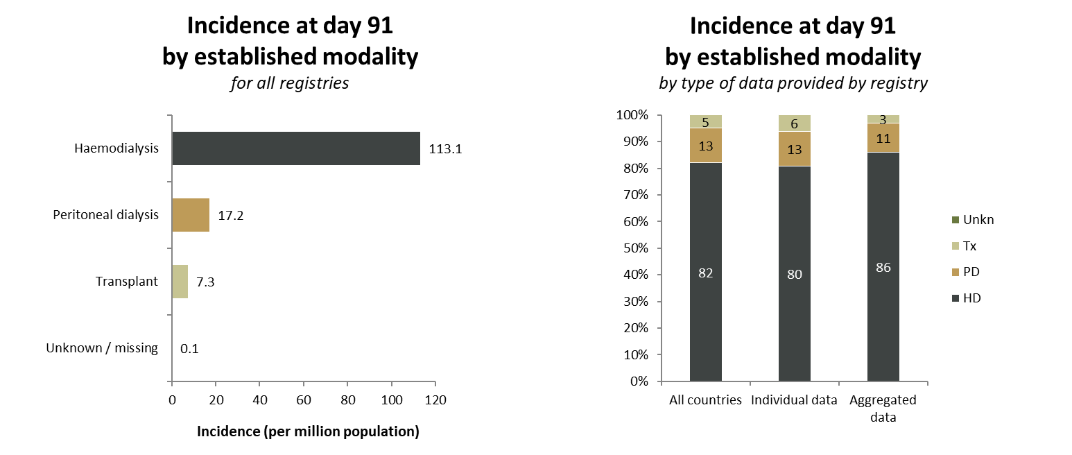
Incident patients accepted for KRT in 2023, at day 91 by established modality

Slide 13
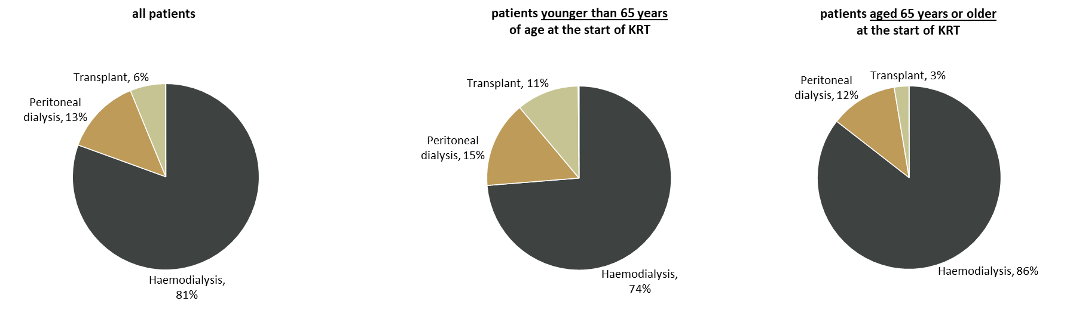
Incident patients accepted for KRT in 2023, at day 91
by established modality and age category
Incidence at day 91 by established modality
patients from registries providing individual patient data only

Slide 14
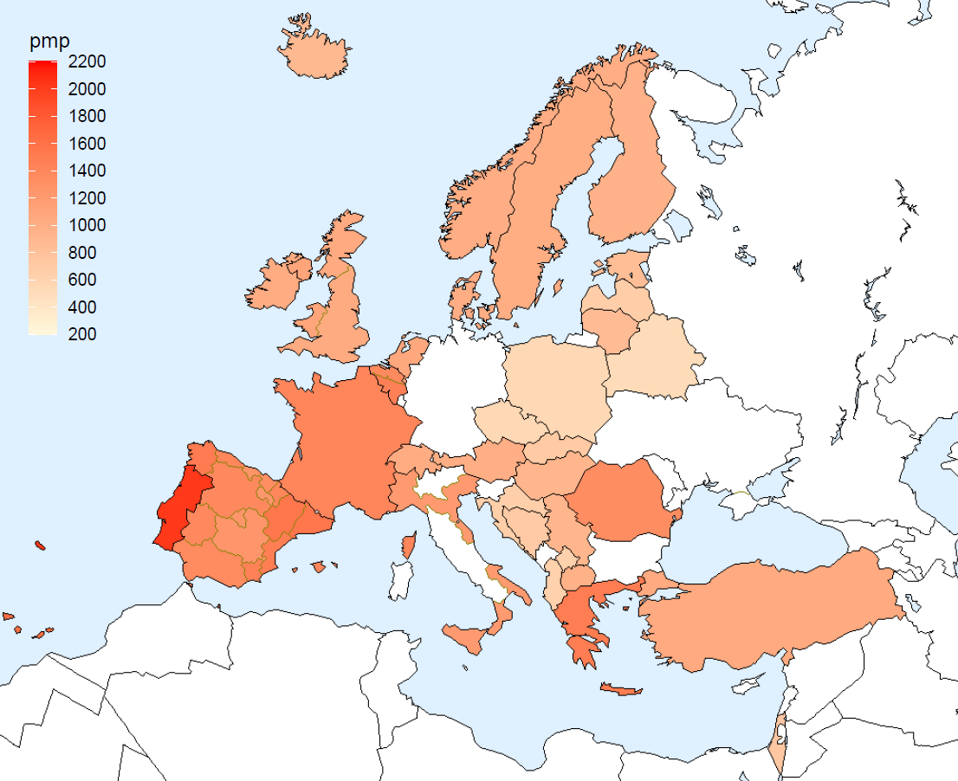
Prevalent patients on KRT in 2023
by country
per million
population
Iceland
Sweden
Finland
Norway
Estonia
Ireland
DK
Latvia
United
Kingdom
Lithuania
NL
Belarus
Belgium
Poland
Czech
Republic
France
Slovakia
Switzerland
Austria
Hungary
Portugal
Croatia
Romania
Spain
BA
Italy
Serbia
XK
MK
AL
Turkey
Greece
Israel

Slide 15
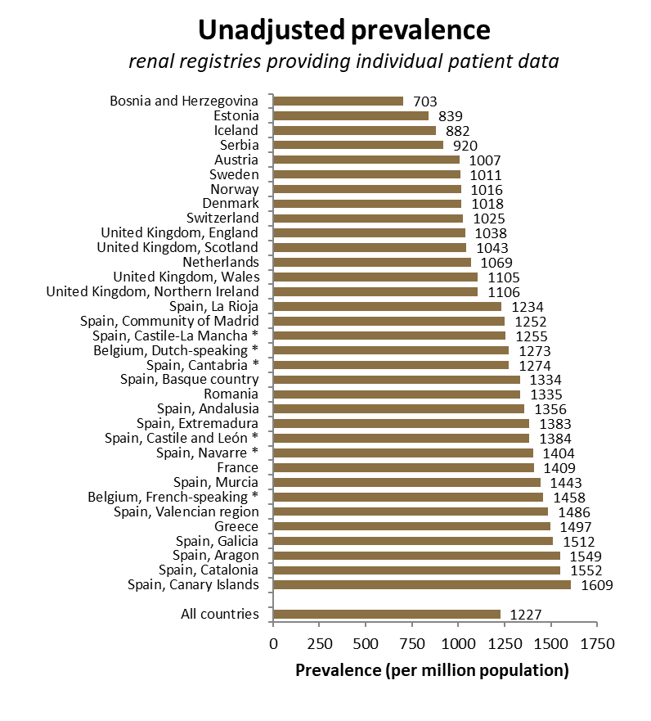
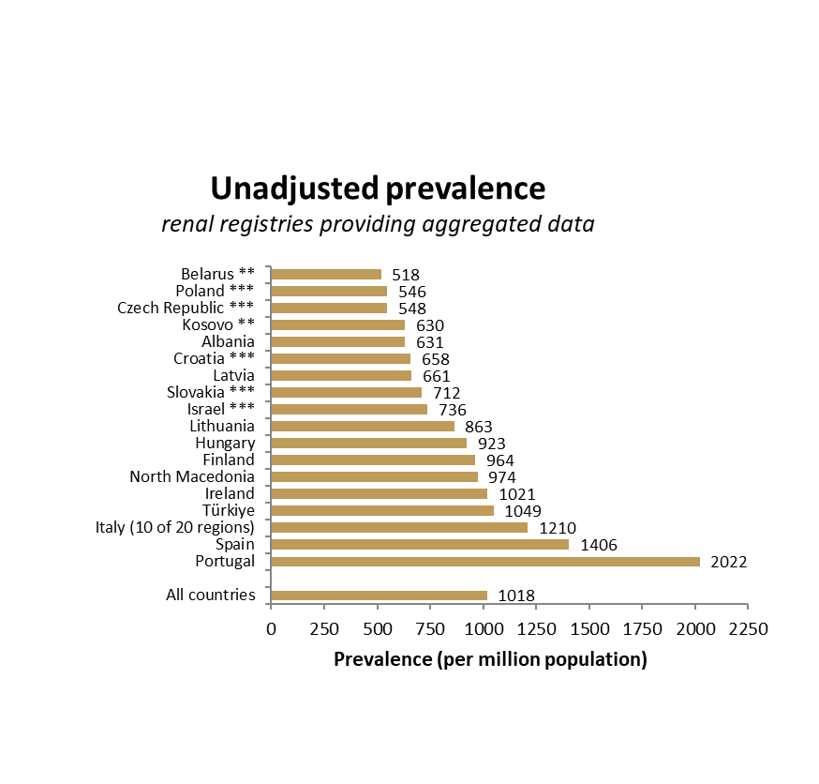
Prevalent patients on KRT in 2023
by country
ª
* patients younger than 20 years of age are not included; ** patients younger than 18 years of age are not included; *** data includes patients receiving dialysis only

Slide 16
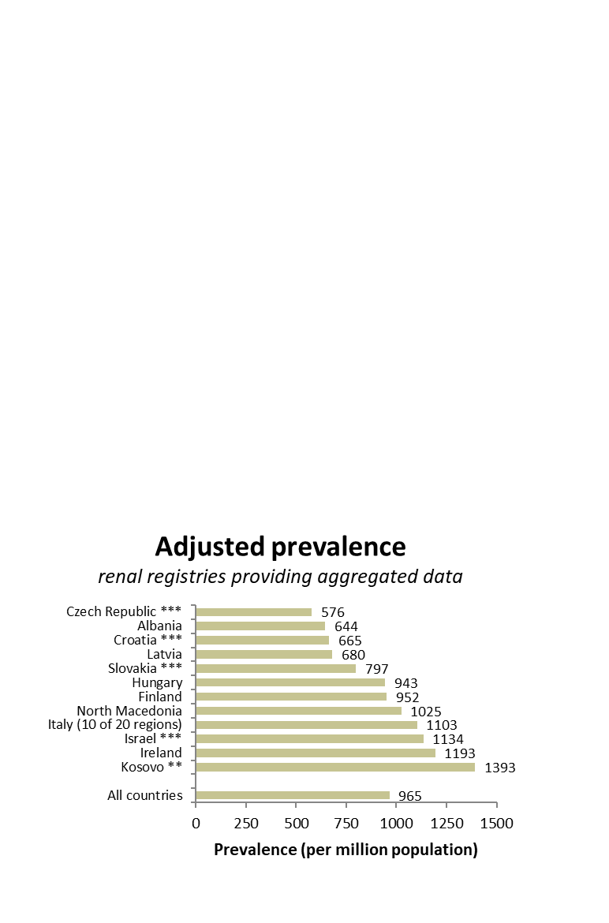
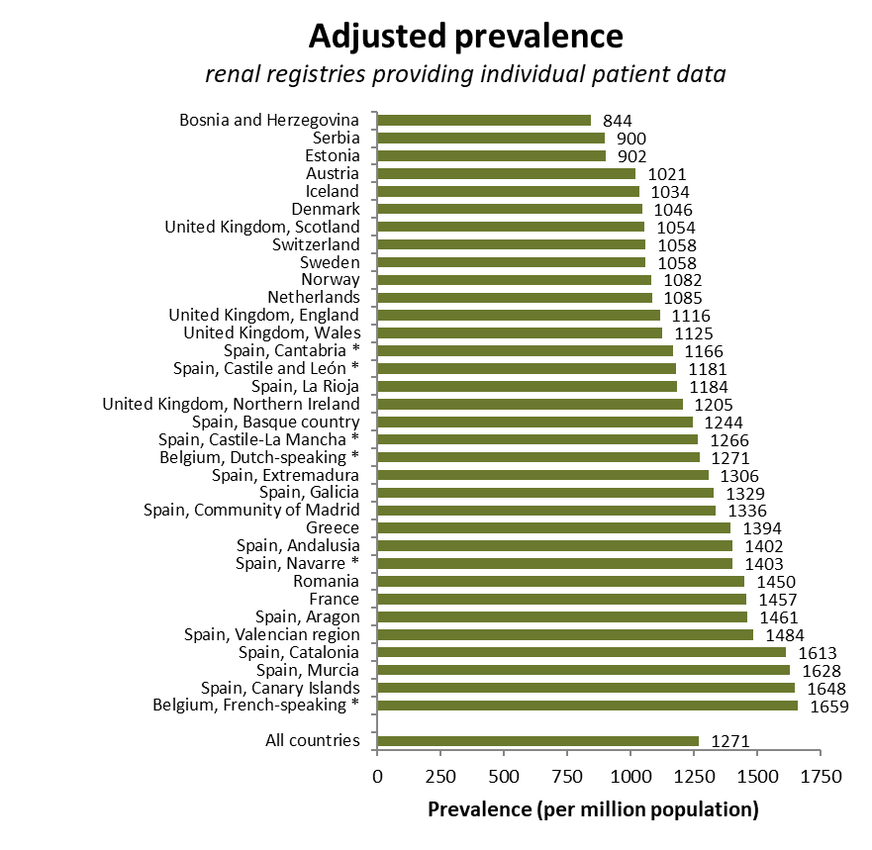
Prevalent patients on KRT in 2023
by country, adjusted for age and sex
* patients younger than 20 years of age are not included; ** patients younger than 18 years of age are not included; *** data includes patients receiving dialysis only

Slide 17
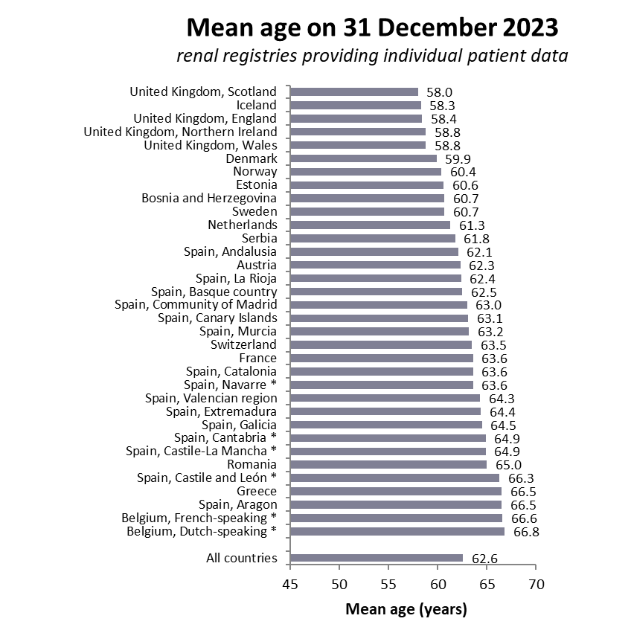
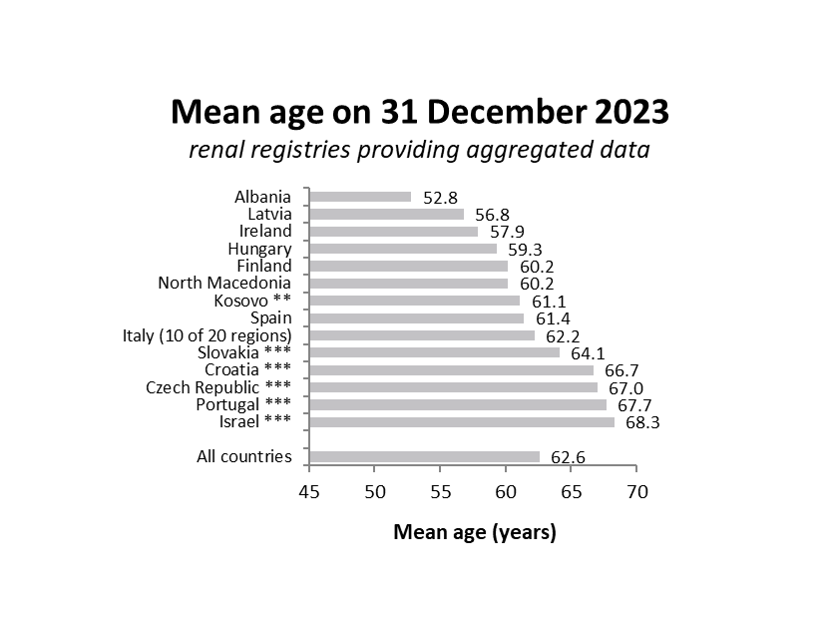
Prevalent patients on KRT in 2023
mean age
* patients younger than 20 years of age are not included; ** patients younger than 18 years of age are not included; *** data includes patients receiving dialysis only

Slide 18
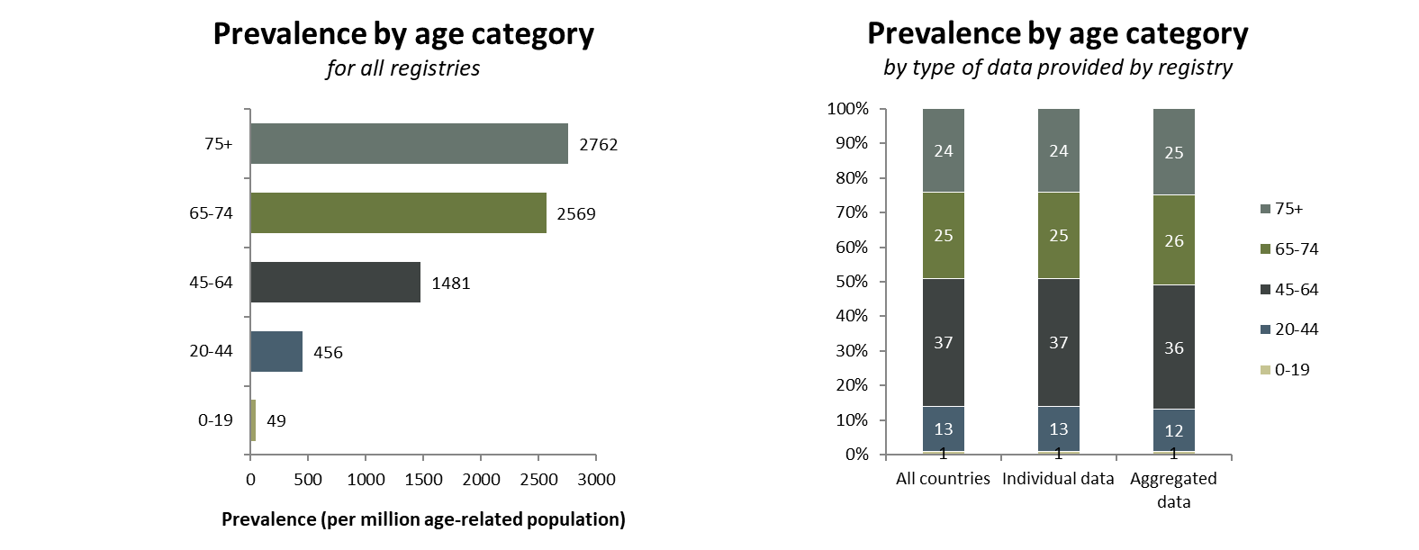
Prevalent patients on KRT in 2023 by age category

Slide 19

Prevalent patients on KRT in 2023
by sex

Slide 20
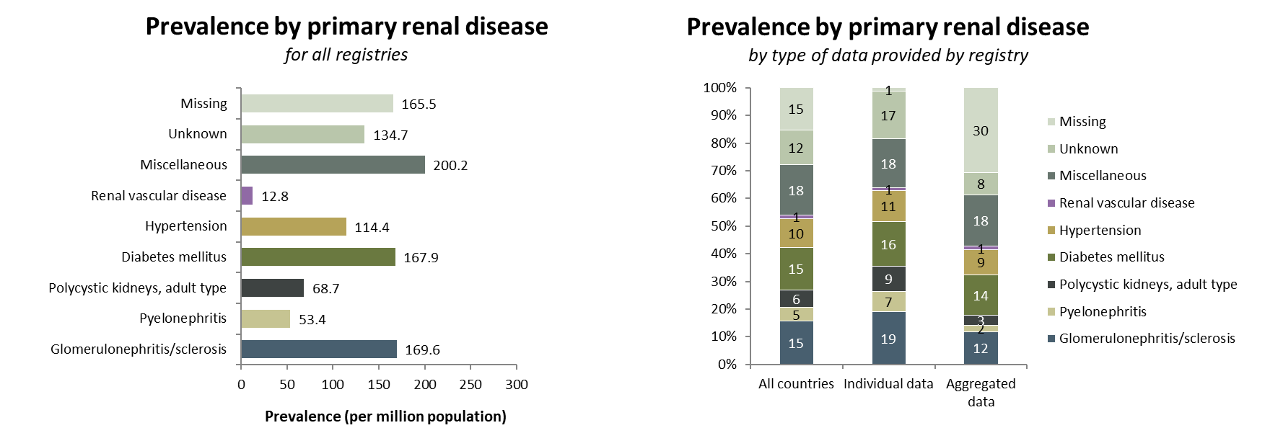
Prevalent patients on KRT in 2023 by primary renal disease (1995 PRD codes)

Slide 21
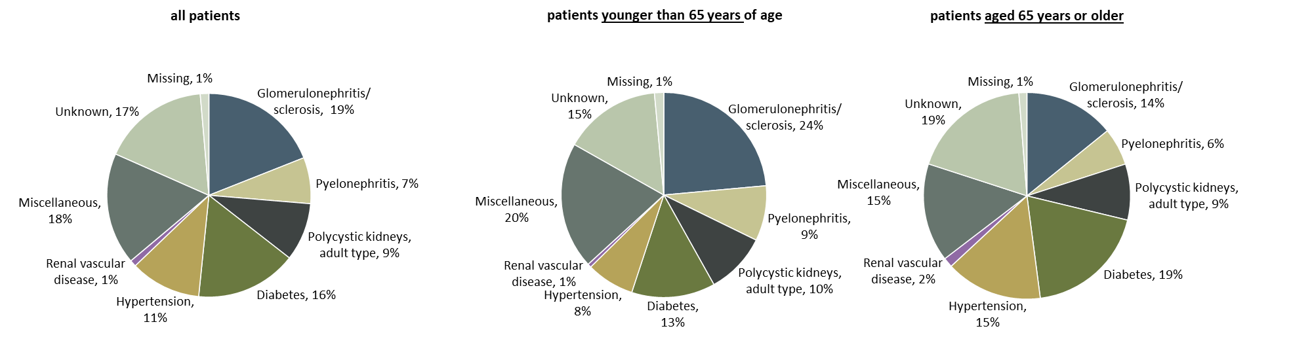
Prevalent patients on KRT in 2023 by primary renal disease (1995 PRD codes) and age category
Prevalence by primary renal disease
patients from registries providing individual patient data only

Slide 22
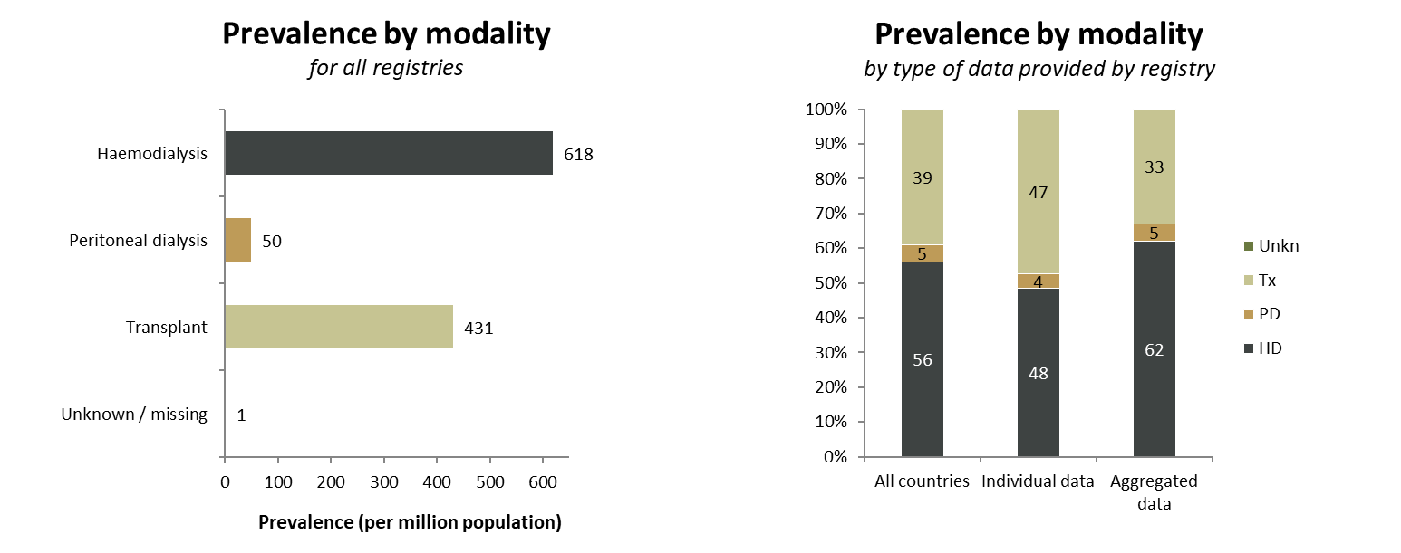
Prevalent patients on KRT in 2023 by modality

Slide 23
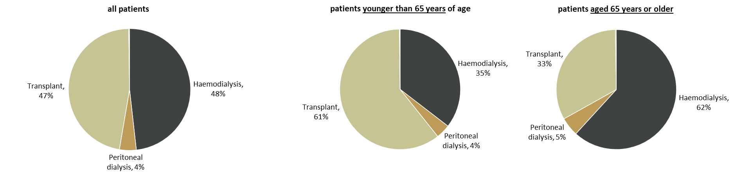
Prevalent patients on KRT in 2023 by modality and age category
Prevalence by modality
patients from registries providing individual patient data only

Slide 24
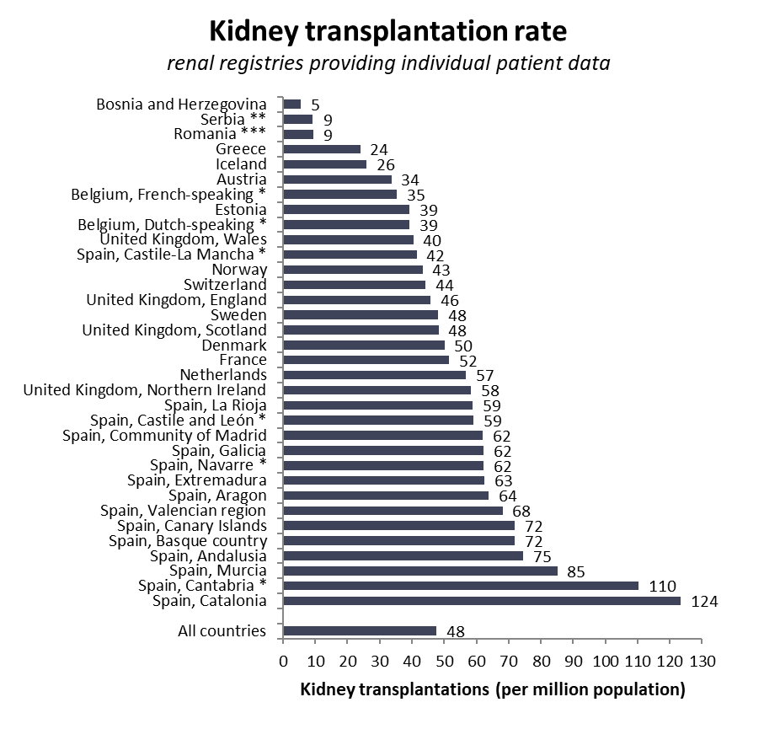
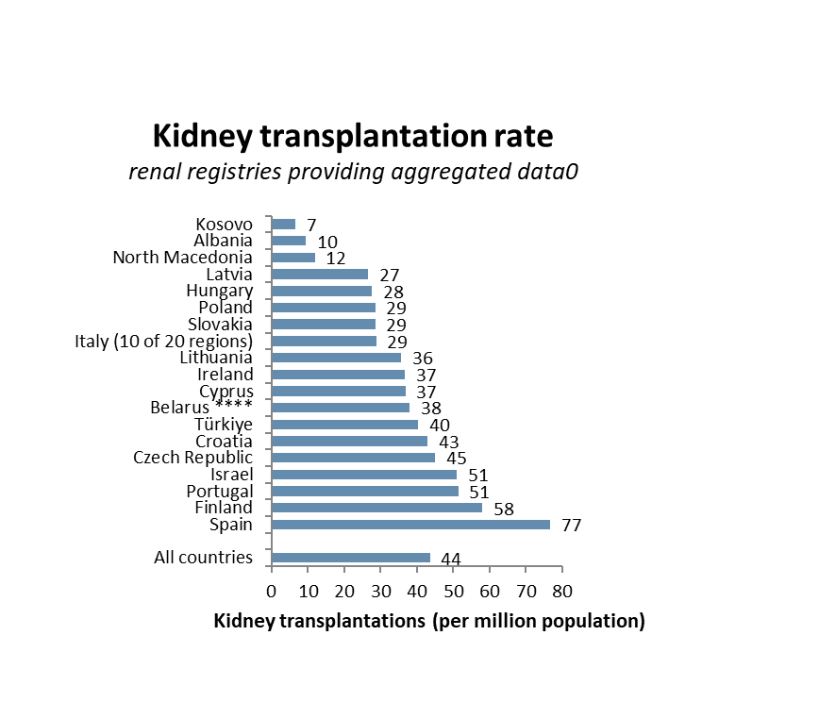
Kidney transplantations performed in 2023
by country
ª
* patients younger than 20 years of age are not included; transplantation rates are underestimated by 15% (**), 30% (***); **** patients younger than 18 years of age are not included

Slide 25
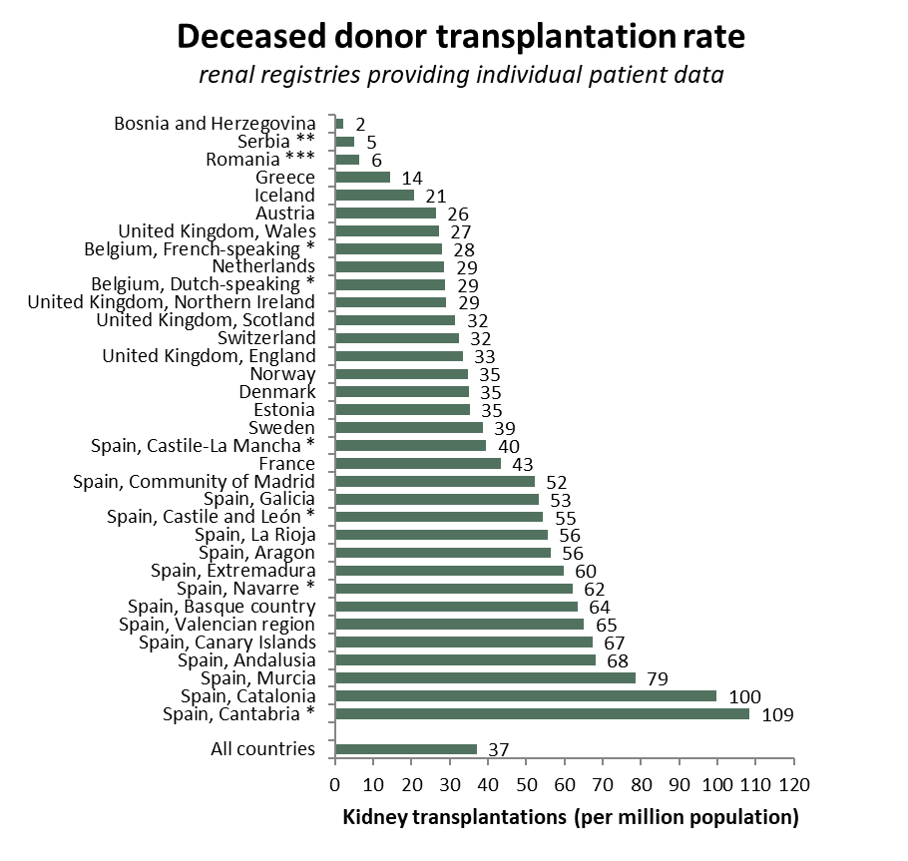
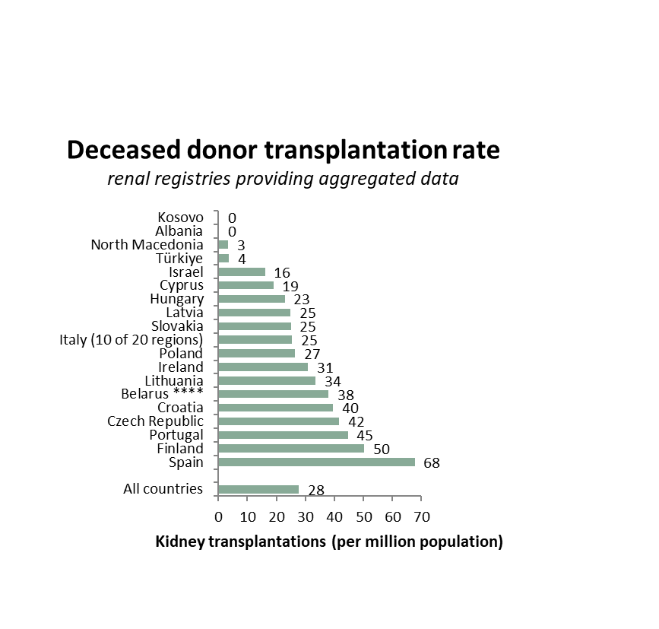
Kidney transplantations performed in 2023
transplants from deceased donors, by country
* patients younger than 20 years of age are not included; transplantation rates are underestimated by 16% (**), 30% (***); **** patients younger than 18 years of age are not included

Slide 26
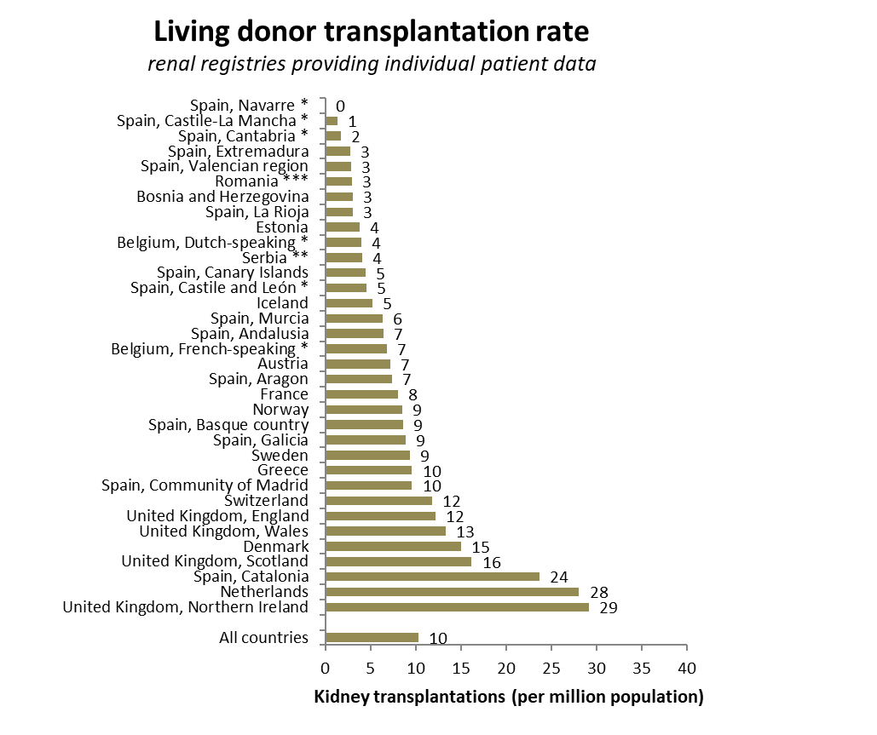
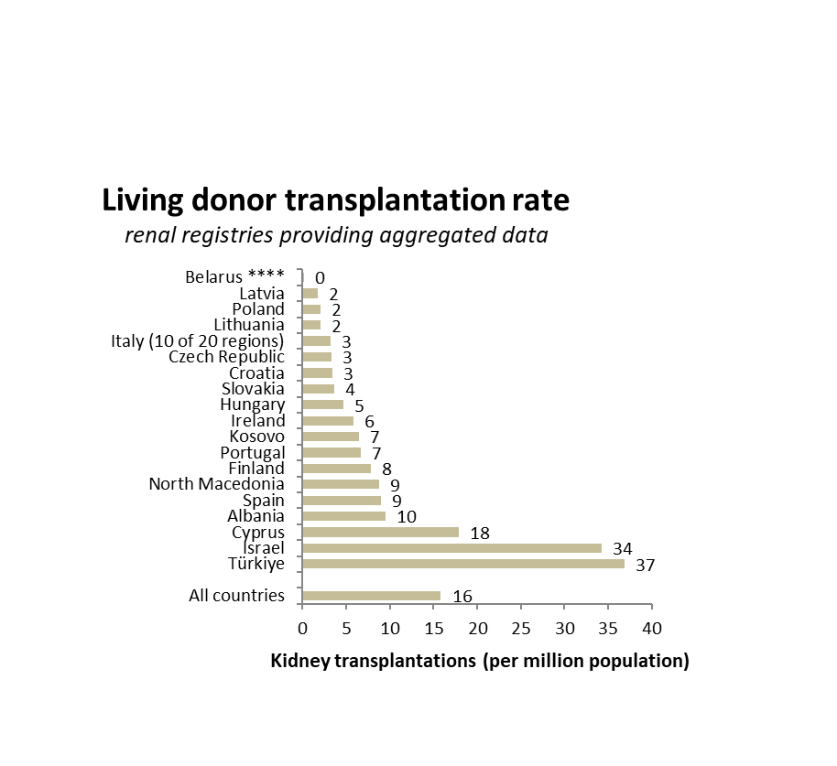
Kidney transplantations performed in 2023
transplants from living donors, by country
* patients younger than 20 years of age are not included; transplant rates are underestimated by 12% (**), 30% (***); **** patients younger than 18 years of age are not included

Slide 27
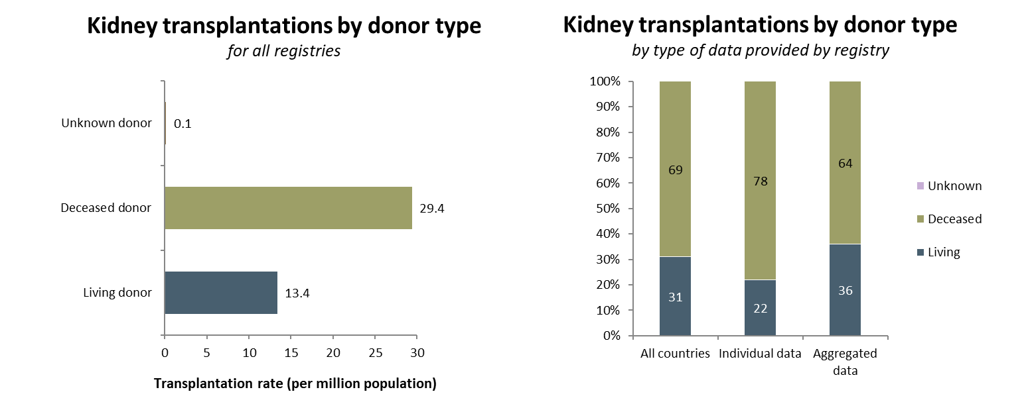
Kidney transplantations performed in 2023 by donor type

Slide 28
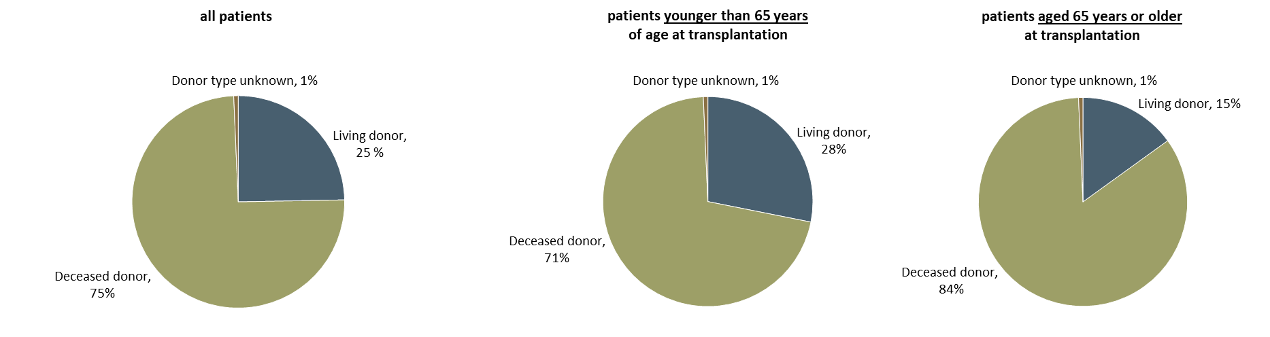
Kidney transplantations performed in 2023 by donor type
Kidney transplantations by donor type
patients from registries providing individual patient data only

Slide 29
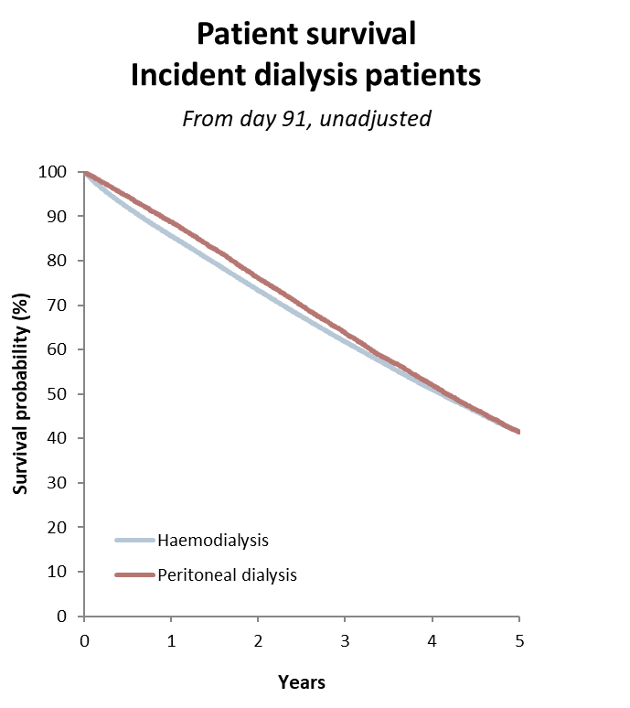
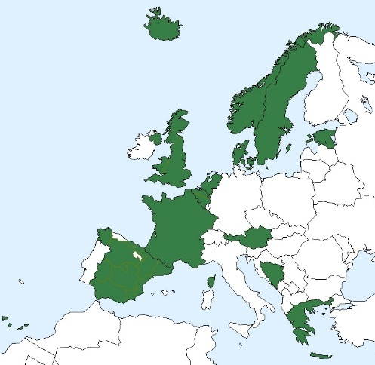
Patient survival by modality
Cohort 2014-2018

Slide 30
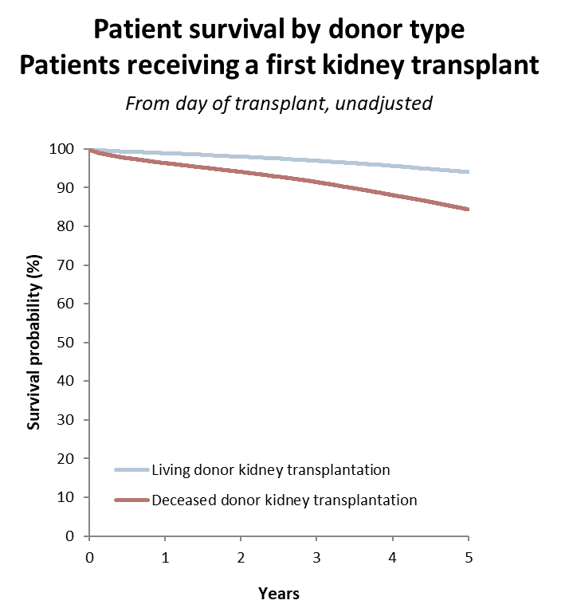
Patient survival by modality
Cohort 2014-2018

Slide 31
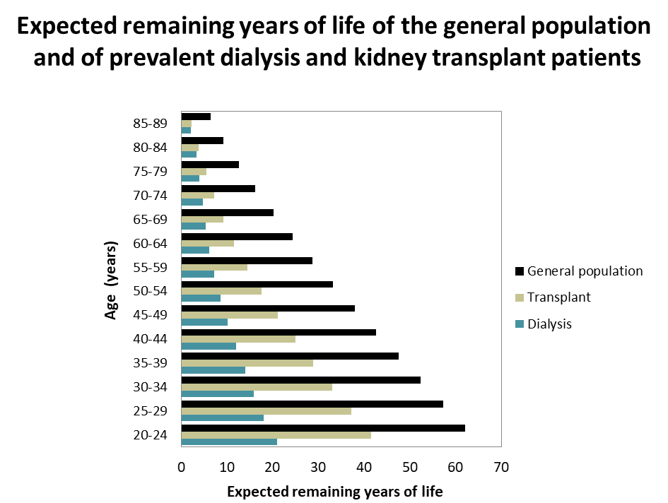
Expected remaining lifetime
prevalent patients (2019-2023)

Slide 32
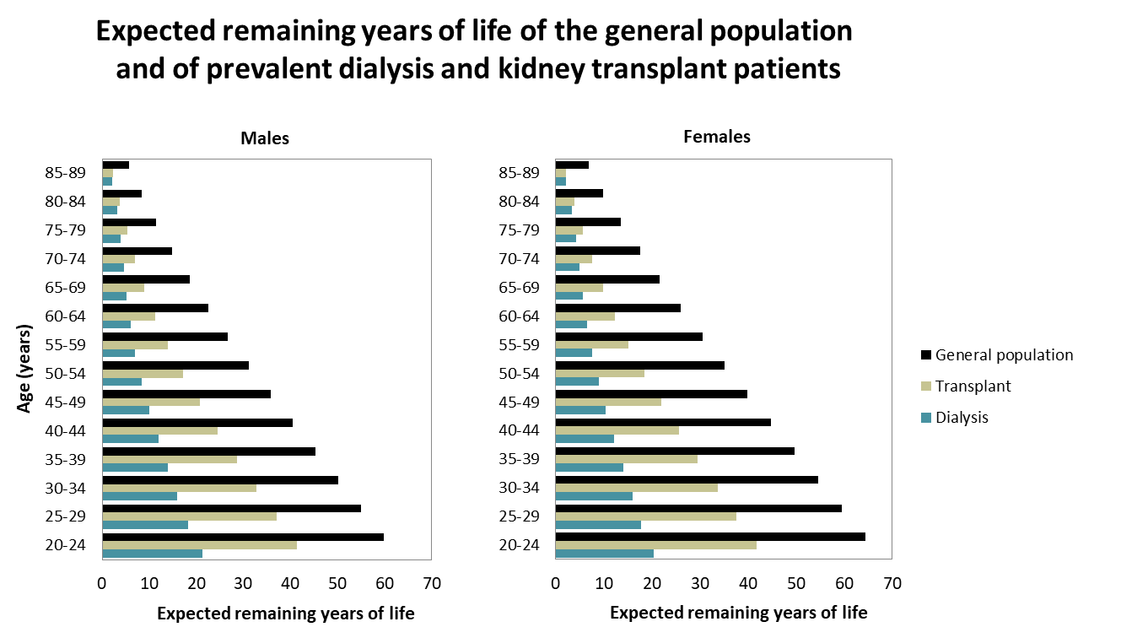
Expected remaining lifetime
prevalent patients (2019-2023)

